Slide 1
Restaurant NYC vs TORONTO

Slide 2
Restaurant
01
02
NYC
Toronto
The Asian Cuisines in NYC are the best
But wines in Toronto is no comparable
70 %
70 %
30 %
30 %

Slide 3
Which Better, Toronto or NYC?
Main Goal
The aim is to help
stakeholders make decisions in different kinds of industrial, hotel, cuisines, and what the city has to offer so tourists around the world can choose their preferences depending on the experiences that either New York or Toronto offer and what would they want.
Option A
Option B
Option C

Slide 4
Data Acquisition and Cleaning
Toronto
NYC
I scrapped the data from https://en.wikipedia.org/wiki/List_of_postal_codes_of_Canada:_M
I also use the dataset from Geospatial_Coordinates.csv
I used Foursquare API Data for Toronto to get Latitude and Longitude
The tor_data i had is containing Postal Code, but i don't need it so i can drop Postal Code column
I downloaded json file from NewYork.json
I used Foursquare API Data for NYC to get Latitude and Longitude

Slide 5
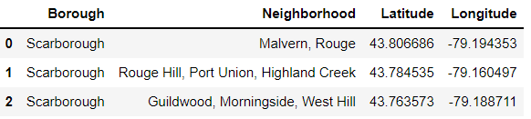
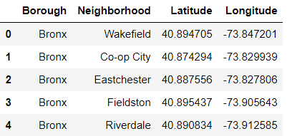
Toronto and NYC Data

Slide 6
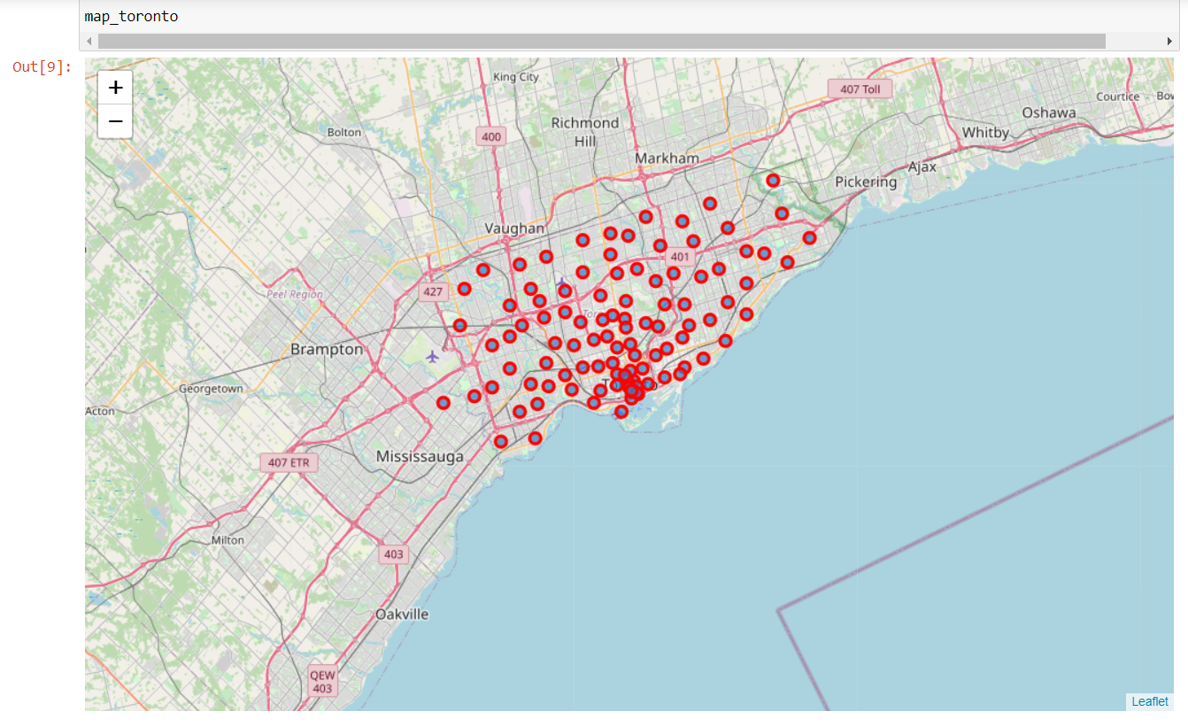
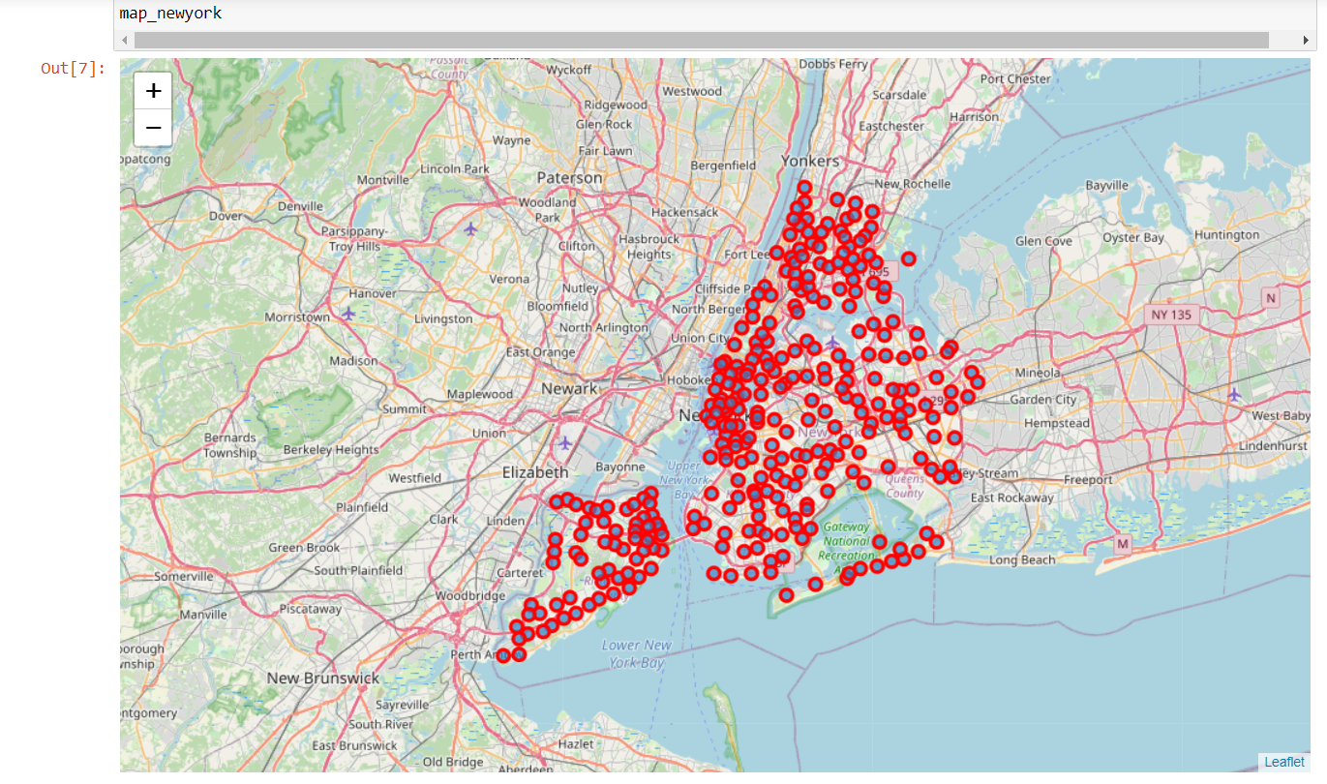
Toronto and NYC Neighborhood
Visualize
Visualizing Toronto and NYC neighborhood using Folium

Slide 7
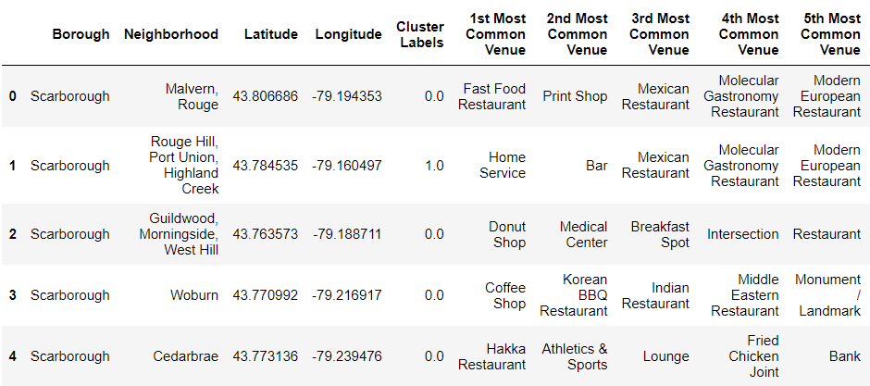
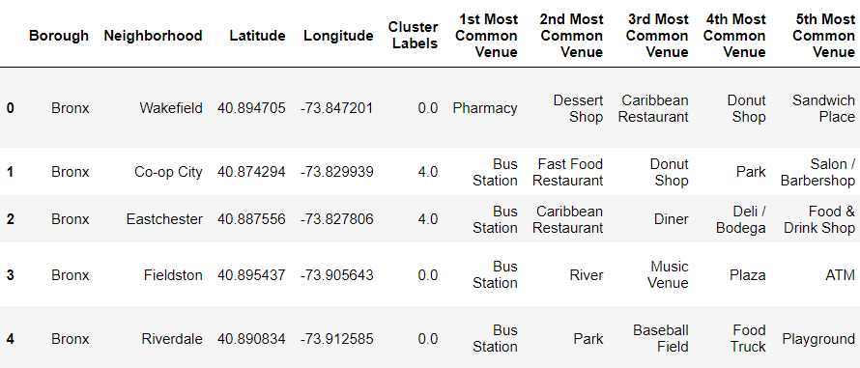
Clusterize the Data using KMeans
Our Restaurant

Slide 8
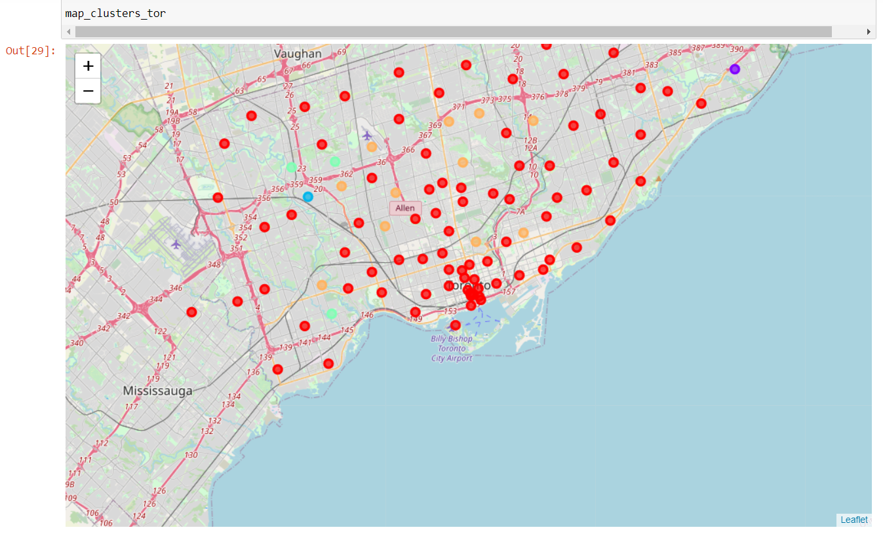
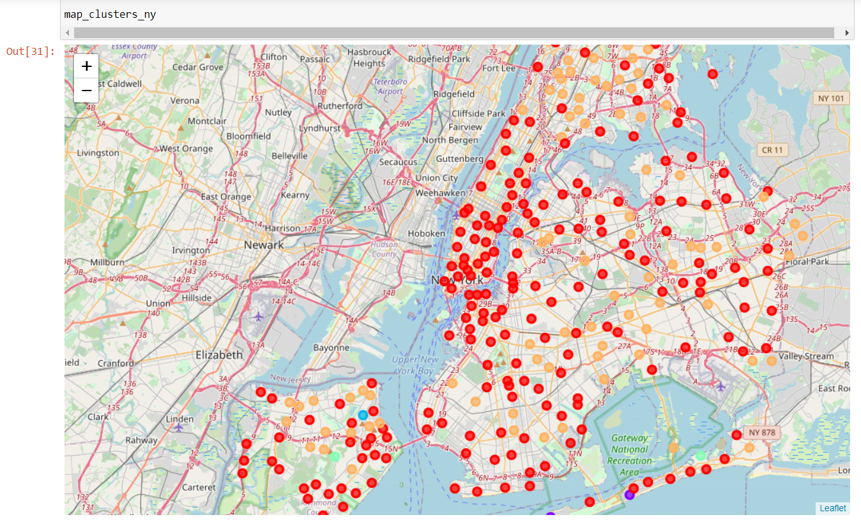
Clustered Map of Toronto and NYC Neighbourhood Venues

Slide 9
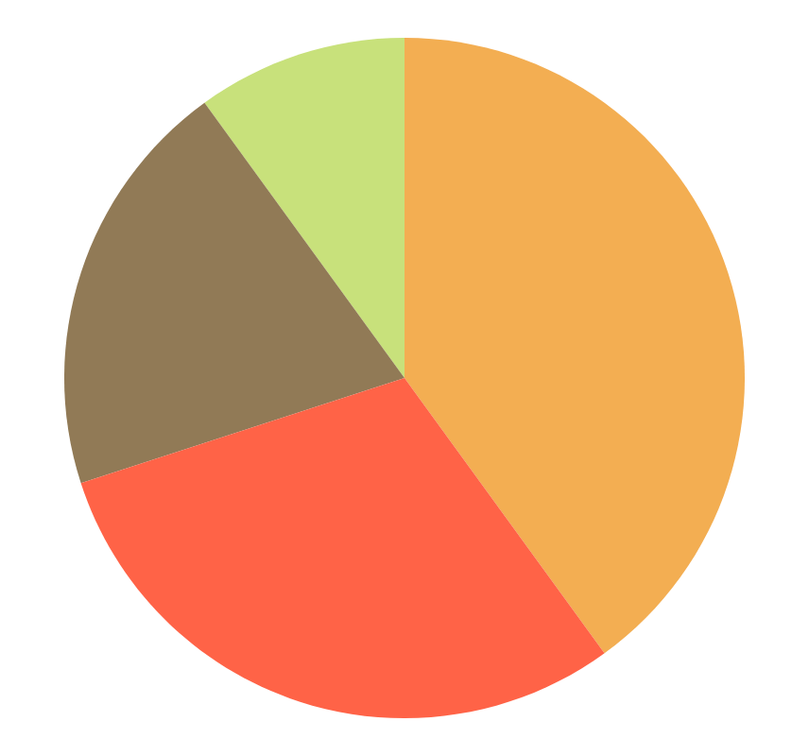
Conclusion and Discussion
Discussion
Conclusion
We can see from the table or the map that the neighborhood between New York and Toronto are much the same. From table we can see that most venues in neighborhood of New York and Toronto are restaurant, cafe, and shopping center. So the stakeholder can predict which business should they open.
The neighborhoods of New York and Toronto are very similar. You can see the most 2 cluster (red and orange) are dominating between other 3 cluster.

